Slide 1
Data Visualisation with R
Interdependency among observations:
Spatial Data & Network Data

Slide 2
Outline
Introduction
Why Visualization of Spatial Data?
Why Visualization of Network Data?
Our Working Example: Data
Goal

Slide 3
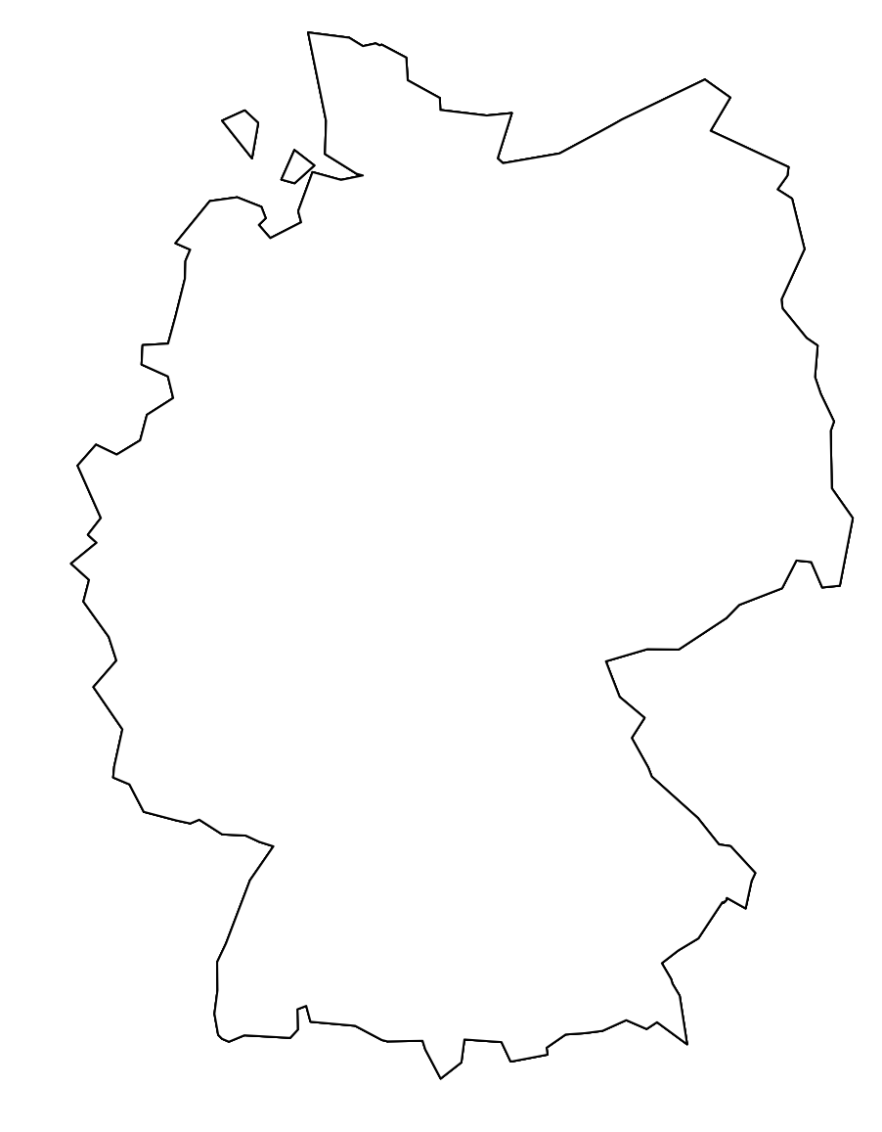
Introduction

Slide 4
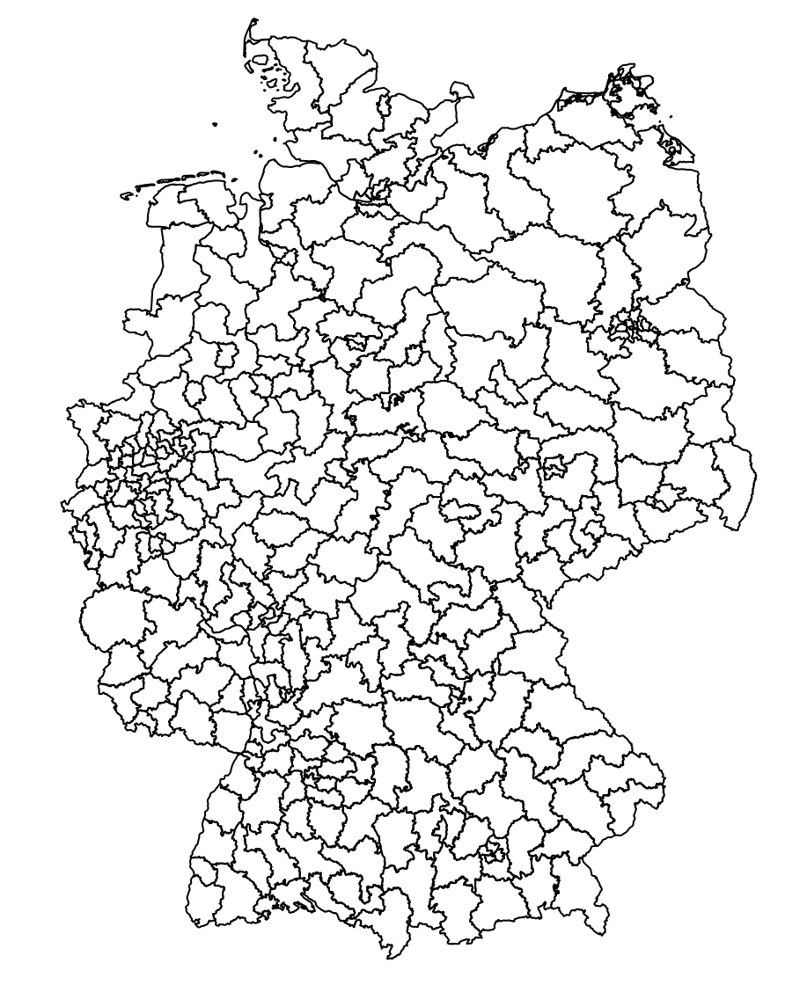
Introduction

Slide 5
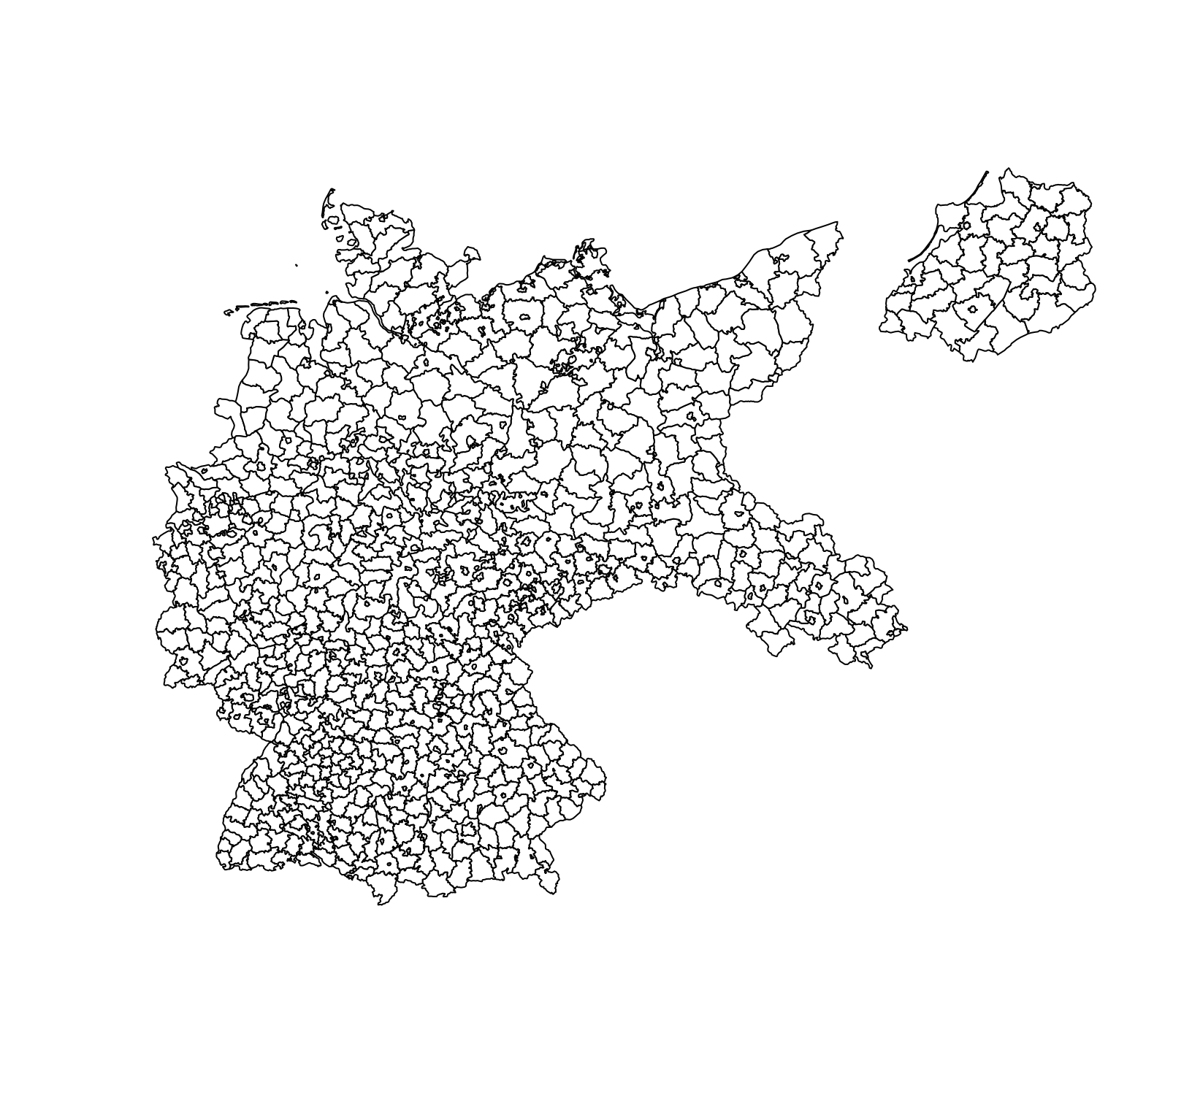
Introduction

Slide 6
Introduction
Municipalities of the German Empire in 1933
German constituencies during the federal elections in 2021
German territory from 3.10.1990 onwards
n=1
n=299
n=948

Slide 7
Why Visualization of Spatial Data?
Descriptive:
Spatial visualizations can help us display our data
Various levels of aggregation possible
Deriving new information:
There might be patterns within our data that might otherwise remain unobserved

Slide 8
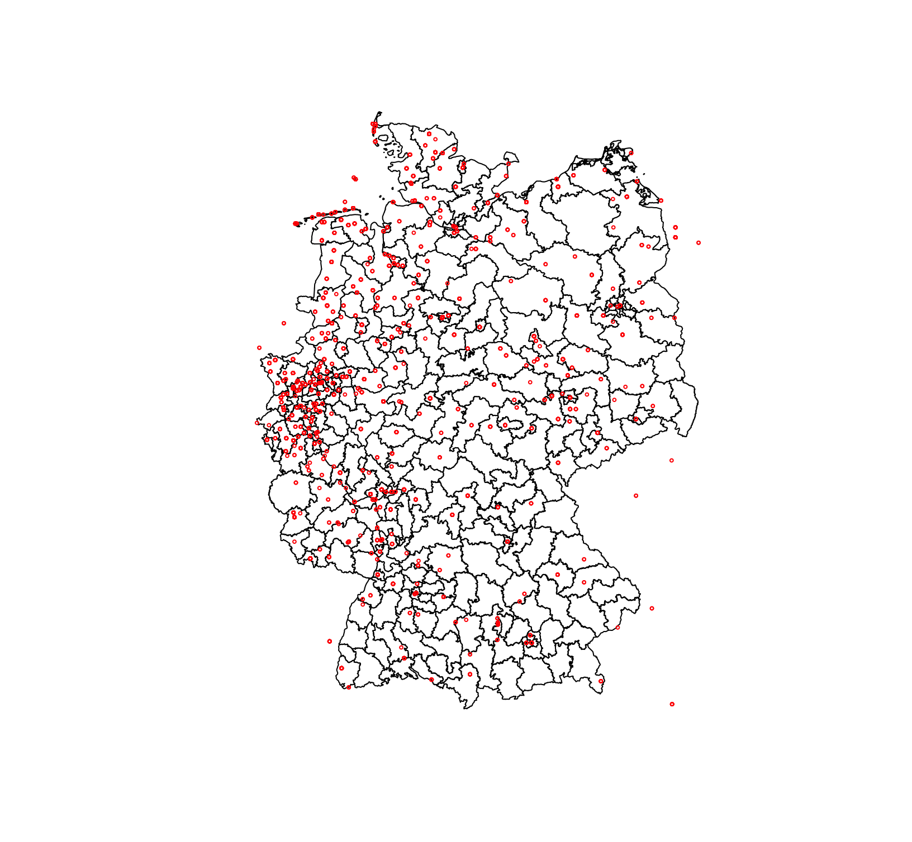
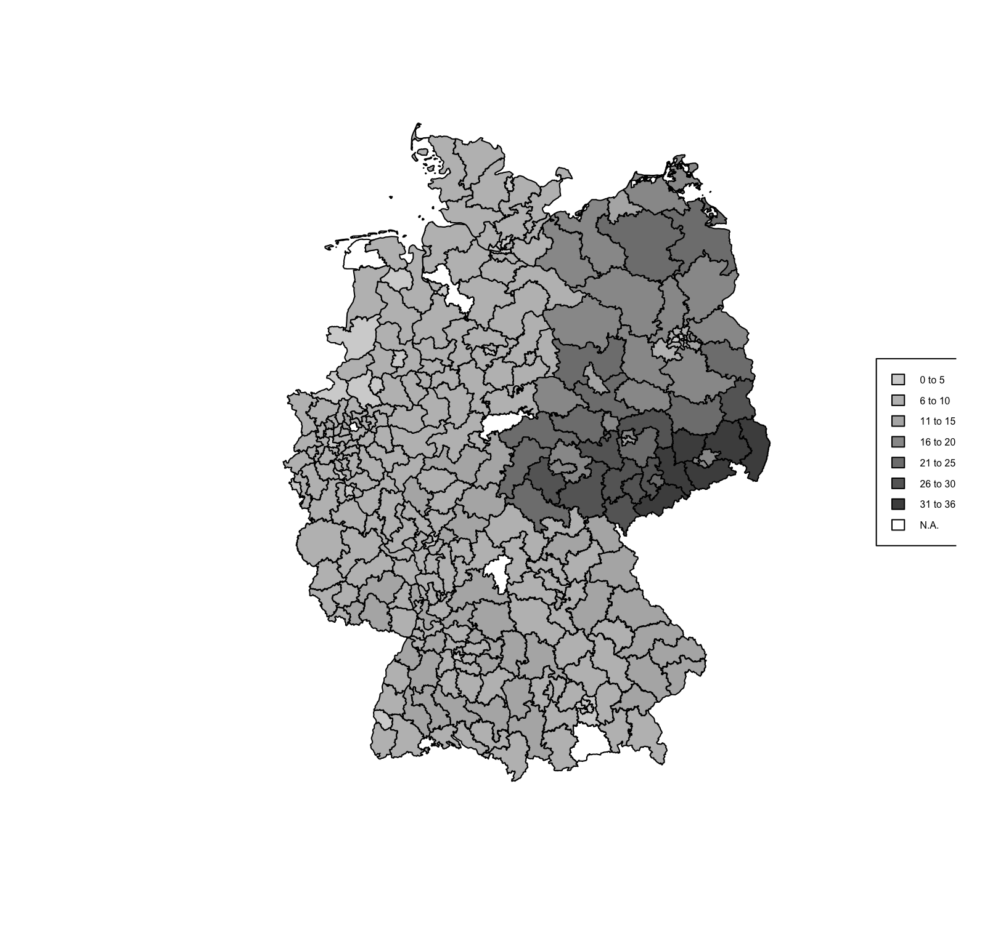
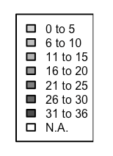
Why Visualization of Spatial Data?
Descriptive:
Spatial visualizations can help us display our data
Various levels of aggregation possible
Deriving new information:
There might be patterns within our data that might otherwise remain unobserved
AfD vote share by constituencies in federal election 2021(Zweitstimme)

Slide 9
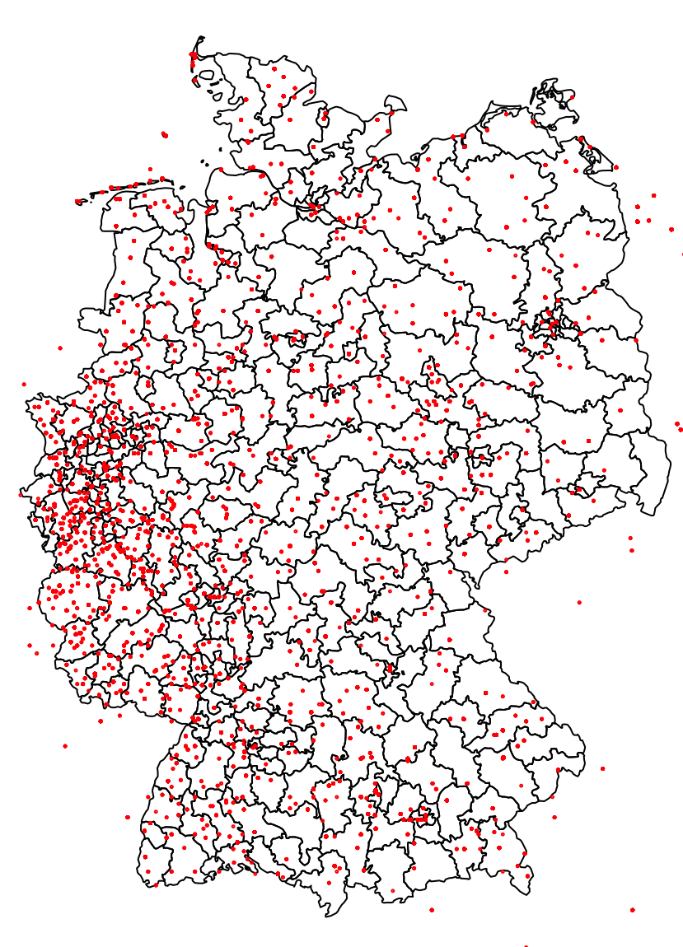
Why Visualization of Spatial Data?
Descriptive:
Spatial visualizations can help us display our data
Various levels of aggregation possible
Deriving new information:
There might be patterns within our data that might otherwise remain unobserved
Allied aerial bombings in WWII

Slide 10
Why Visualization of Spatial Data?
Descriptive:
Spatial visualizations can help us display our data
Various levels of aggregation possible
Deriving new information:
There might be patterns within our data that might otherwise remain unobserved
Allied aerial bombings in WWII
Spatial Dependence

Slide 11
Why Visualization of Network Data?
Individuals, parties, countries interact with each other
We can also study social interactions and dependencies among actors

Slide 12
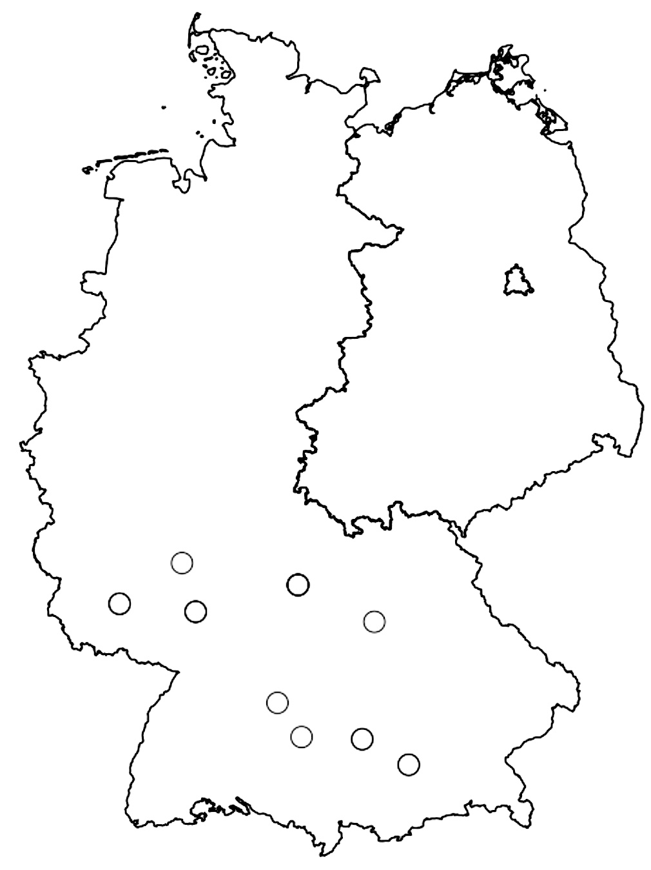
Why Visualization of Network Data?
Individuals, parties, countries interact with each other
We can also study social interactions and dependencies among actors
Location of U.S. American artillery and infantry regiments in Germany in 1957

Slide 13
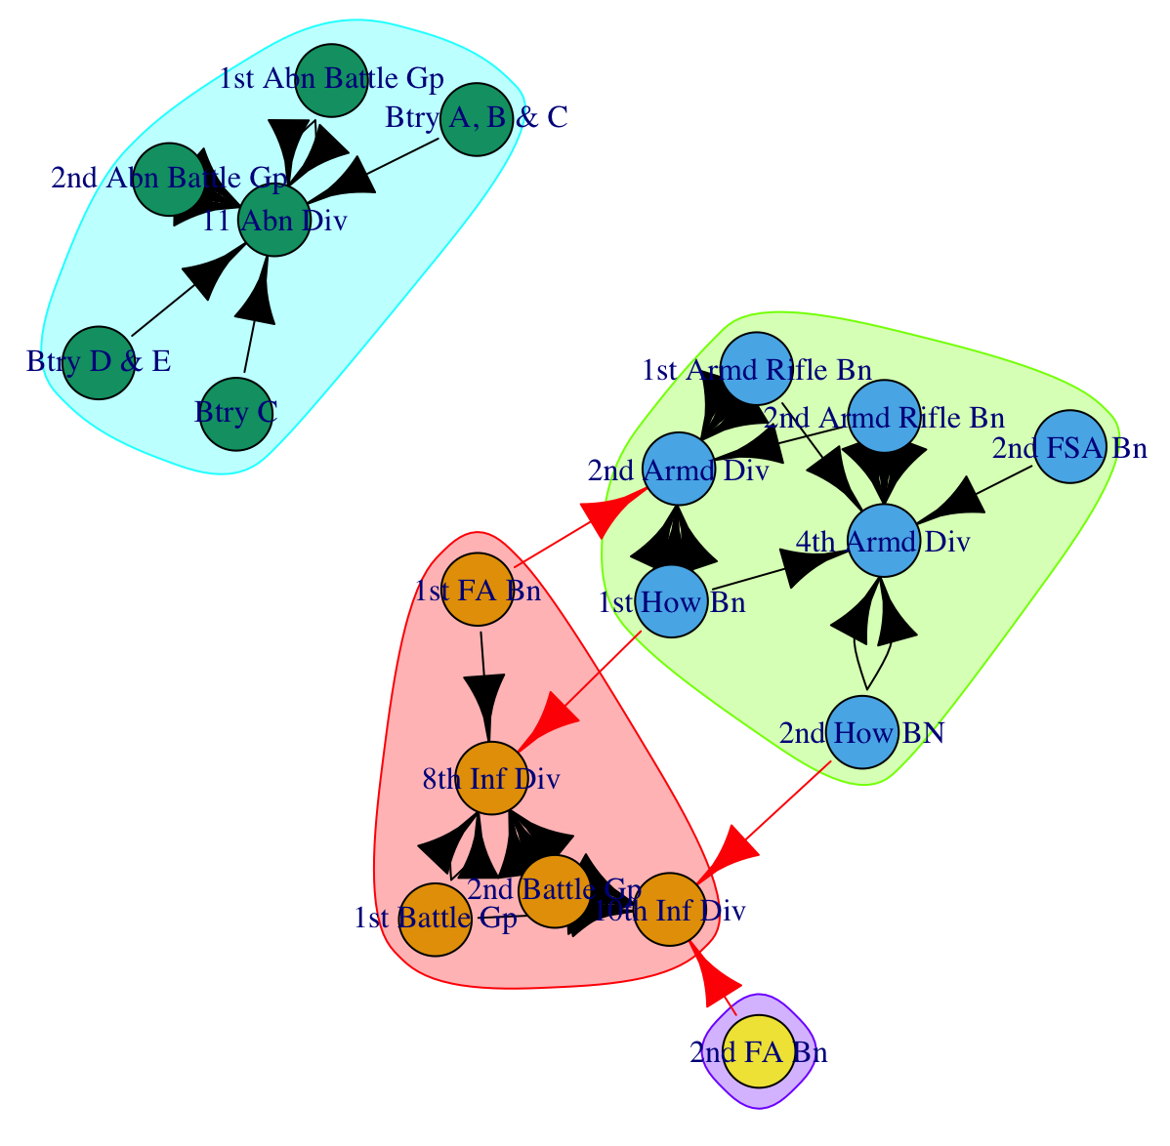
Why Visualization of Network Data?
Individuals, parties, countries interact with each other
We can also study social interactions and dependencies among actors
Network of U.S. American artillery and infantry regiments in Germany in 1957

Slide 14
Outline
Introduction
Why Visualization of Spatial Data?
Why Visualization of Network Data?
Our Working Example: Data
Goal

Slide 15
Outline
Introduction
Why Visualization of Spatial Data?
Why Visualization of Network Data?
Our Working Example: Data
Goal

Slide 16
Our Working Example: Data
ID | Visits
Italy | 6
Poland | 10
Germany | 19
Sweden | 13
Total | 48

Slide 17
Goal
Today, we want to illustrate the number of visits 4 countries make to each other
We do this using two different kinds of data:
Spatial Data
Network Data

Slide 18
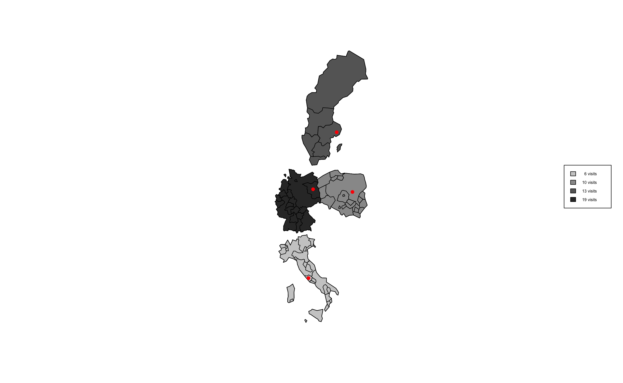
Goal
Today, we want to illustrate the number of visits 4 countries make to each other
We do this using two different kinds of data:
Spatial Data
Network Data

Slide 19
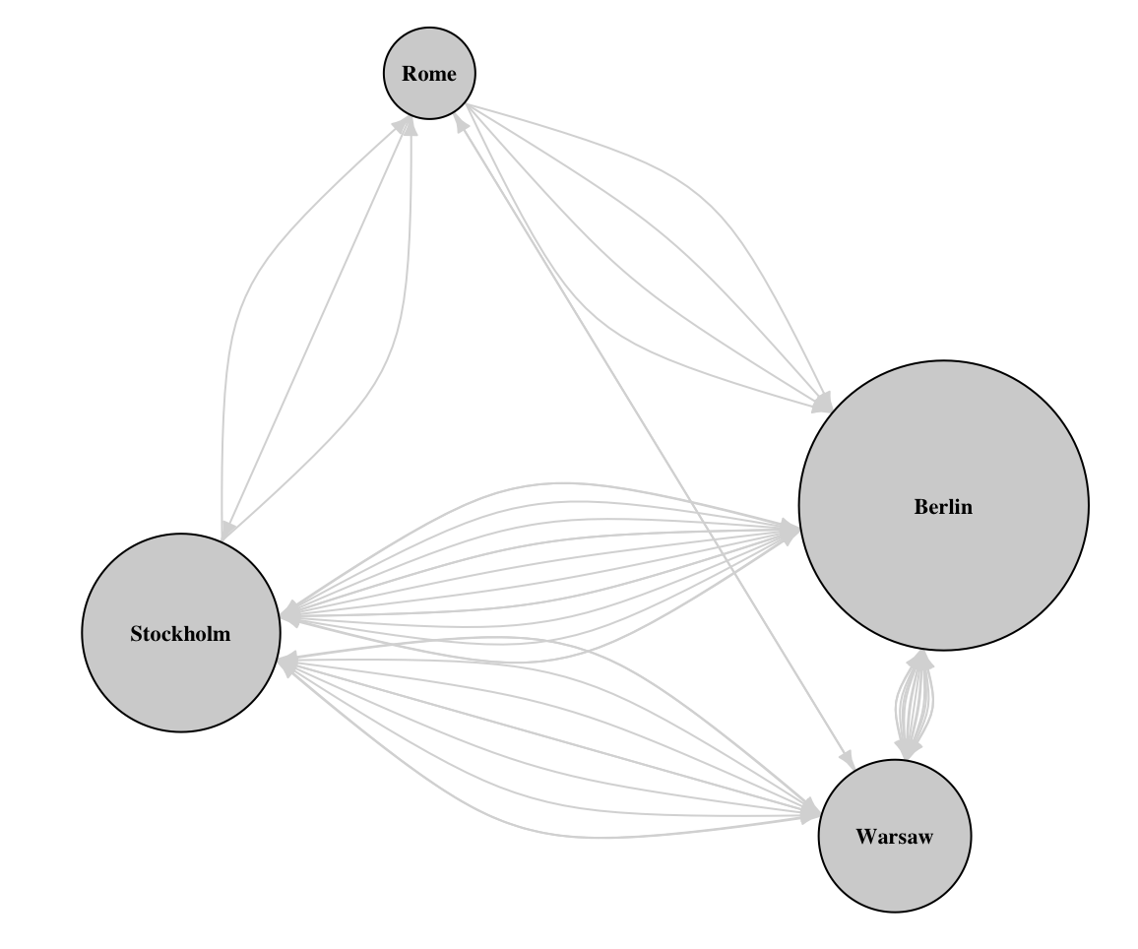
Goal
Today, we want to illustrate the number of visits by country
We do this using two different kinds of data:
Network Data
Spatial Data

Slide 20
Let’s switch to R

